Slide 1
Databases 4
Normalisation
Ashley Cahill
ashley.cahill@tus.ie

Slide 2
Topics
Database Normalisation

Slide 3
Database Tables and Normalisation
Normalisation is the process where a database is designed in a way that removes redundancies, and increases the clarity in organising data in a database.
Normalisation usually involves dividing large tables into smaller (and less redundant) tables and defining relationships between them.
The objective is to isolate data so that additions, deletions, and modifications of a field can be made in just one table.

Slide 4
Database Tables and Normalisation
Normalisation should be part of the database design process.
However, it is difficult to separate the normalisation process from the ER modelling process so the two techniques should be used concurrently.

Slide 5
Database Tables and Normalisation
There are 6 Levels of Normalisation.
Edgar F. Codd, the inventor of the relational model, introduced the concept of Normalisation and what we now know as the First Normal Form (1NF) in 1970.
Codd went on to define the Second Normal Form (2NF) and then Third Normal Form (3NF) in 1971.

Slide 6
Database Tables and Normalisation
Codd and Raymond F. Boyce defined the Boyce-Codd Normal Form (BCNF) in 1974.
Informally, a relational database table is often described as "normalised" if it is in the Third Normal Form (3NF).

Slide 7
Objectives of Normalisation
A basic objective of the first normal form defined by Codd in 1970 was to permit data to be queried and manipulated using a "universal data sub-language".
SQL is an example of such a data sub-language

Slide 8
1NF Normal Form Overview
1NF
Most basic form of Data Normalisation.
An entity is in the First Normal Form if it contains No repeating groups.
Each entry must have only one single value for each cell and each record must be unique.
To normalise a relation that contains a repeating group, remove the repeating group and form two new relations.

Slide 9
First Normal Form: 1NF
An entity is in the first normal form if it contains no repeating groups.
In relational DB, a table is in the first normal form if it contains no repeating columns.

Slide 10

Repeating Groups
Consider an Invoice table.
Each row represents an invoice

Slide 11
Repeating Groups
Consider an Invoice table.
Each row represents an invoice
Because an invoice can have 1 or more line items, however, the item_description column must be repeated to provide for the max number of line items.
But since most invoices have fewer line items than the max, this can waste storage space

Slide 12
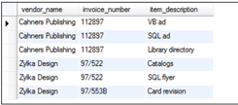
Repeating Groups – Redundant Data
Here each line item is stored in a separate row, this eliminates the problem caused by repeating the item_description column, but it introduces a new problem: the invoice number must be repeated in each row.

Slide 13
Repeating Groups – Redundant Data
1NF
Columns must not contain repeating values.
Each column must contain a single value.
Also the table must not contain repeating columns that represent a set of values.

Slide 14
2NF Normal Form Overview
2NF
An entity adheres to 1NF.
An entity is in the second normal form if all of its attributes depend on the whole primary key.

Slide 15
Second Normal Form: 2NF
An entity is in the second normal form if all of its attributes depend on the whole primary key.
In relational terms, every column in a table must be functionally dependent on the whole primary key of that table.
Functional dependency indicates that a link exists between the values in two different columns.

Slide 16
Converting From 1NF to 2NF
To convert first-normal-form tables to second-normal-form tables, remove columns that are not dependent on the primary key.

Slide 17
3NF Normal Form Overview
3NF
An entity adheres to 1NF & 2NF.
An entity is in the third normal form if it contains no transitive dependency

Slide 18
Third Normal Form: 3NF
An entity is in the third normal form if it contains no transitive dependencies.
A transitive dependency is one which is dependant on a non-key attribute.

Slide 19
Converting From 2NF to 3NF
To convert to third normal form, remove attributes that depend on non primary key attributes.

Slide 20
Objectives of Normalisation Beyond 1NF
The objectives of Normalisation beyond 1NF (First Normal Form) were stated as follows by Codd:
To free the collection of relations from undesirable insertion, update and deletion anomalies
To reduce the need for restructuring of collections as new data types are introduced
To make the relational model more informative to users
To avoid bias towards any querying pattern

Slide 21
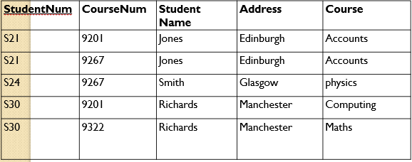
Insertion Anomaly
An Insert Anomaly occurs when certain attributes cannot be inserted into the database without the presence of other attributes.
For example we can't add a new course unless we have at least one student enrolled on the course.

Slide 22
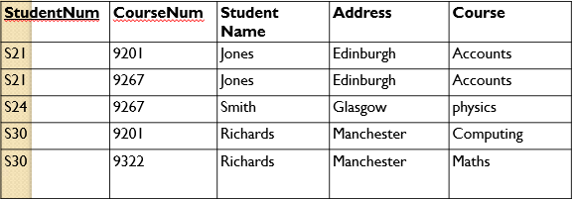
Update Anomaly
An Update Anomaly exists when one or more instances of duplicated data is updated, but not all.
For example, consider Jones moving address - you need to update all instances of Jones's address.

Slide 23
Deletion Anomaly
A Deletion Anomaly exists when certain attributes are lost because of the deletion of other attributes.
For example, consider what happens if Student S30 is the last student to leave the course - All information about the course is lost.

Slide 24
Minimise Redesign When Extending the Database Structure
When a fully normalised database structure is extended to allow it to accommodate new types of data, the pre-existing aspects of the database structure can remain largely or entirely unchanged.
As a result, applications interacting with the database are minimally affected.

Slide 25
Make the Data Model More Informative to Users
Normalised tables, and the relationship between one normalised table and another, mirror real-world concepts and their interrelationships.

Slide 26
Avoid Bias Towards Any Particular Pattern of Querying
Normalised tables are suitable for general-purpose querying.
This means any queries against these tables, including future queries whose details cannot be anticipated, are supported.
In contrast, tables that are not normalised lend themselves to some types of queries, but not others.

Slide 27

Normalisation Example
Take the following table.
StudentID is the primary key
Is this in 1NF?

Slide 28
Normalisation Example – 1NF
Is this in 1NF?
No, there are repeating groups… (Subject, SubjectCost, Grade)

Slide 29

Normalisation Example – 1NF
Becomes
Repeating Groups have been removed

Slide 30
Normalisation Example – 1NF
Becomes
The primary key of the Subject table is Student ID and Subject

Slide 31
Normalisation Example – 2NF
Is this in 2NF?
No, there fields not dependant on Primary Key

Slide 32
Normalisation Example – 2NF
Is this in 2NF?
No, To Convert to 2NF Remove Attributes Which Are Not Dependent on Whole Primary Key

Slide 33
Normalisation Example – 2NF
Is this in 2NF?
No, To Convert to 2NF Remove Attributes Which Are Not Dependent on Whole Primary Key
Subject Cost depends on Subject but not on Student ID so it needs to be removed

Slide 34



Normalisation Example – 2NF
To Convert to 2NF Remove Attributes Which Are Not Dependent on Whole Primary Key
Becomes
Subject Cost has been moved to a subject table.

Slide 35
Normalisation Example – 3NF
Is it in 3NF?

Slide 36
Normalisation Example – 3NF
To Convert to 3NF Remove Transitive Dependencies
Which Attribute is not Dependent on the Primary key?

Slide 37
Normalisation Example – 3NF
To Convert to 3NF Remove Transitive Dependencies
Which Attribute is not Dependent on the Primary key?
Mentor Office is dependant on Mentor Name (not StudentID)

Slide 38



Normalisation Example – 3NF
To Convert to 3NF Remove Transitive Dependencies
Becomes

Slide 39
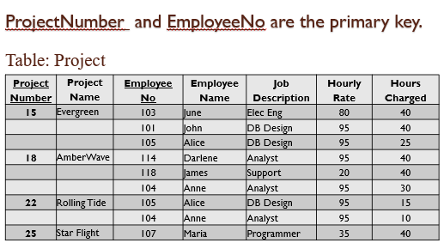
Exercise
Is this table Normalised?

Slide 40
Exercise
Normalise this table to 3NF?

